Slide 1



Slide 2



 | Slope Bins 4 | Smear Count 25
Block number | Alpha w/ Henderson Hasselbalch | Chi Chi_max = 2.2
[0 50] | 0.040012 | 1.160000
[50 75] | -0.278451 | 0.720000
[75 125] | -0.519707 | 0.608000
[125 156] | -0.154453 | 0.529032

Slide 3


 | Slope Bins 4 | Smear Count 31
Block number | Alpha w/ Henderson Hasselbalch | Chi Chi_max = 2.2
[0 31] | 0.001103 | 0.922581
[31 62] | -0.386873 | 0.703226
[62 93] | -0.290146 | 0.967742
[93 496] | 0.037164 | 1.098759
[496 527] | -0.064533 | 0.819355
[527 620] | 0.010682 | 0.756989
[620 647] | -0.103326 | 0.696296

Slide 4
Binary results

Slide 5





NFL
NFH
H volume too low to neutralize L

Slide 6
L/H Fitting

Slide 7







v2.7 and some fine
b1.50 v2.7 c3.2
b1.75 v2.7 c3.2
b1.75 v2.5 c3.2
b1.75 v2.5 c3.0
b2.0 v2.7 c3.2
b2.25 v2.7 c3.2
b2.50 v2.7 c3.2
Phi too small to decrease v0

Slide 8










b2.0 v2.0 c3.0
b2.0 v10.0 c3.0
b2.0 v8.0 c3.0
b2.0 v6.0 c3.0
b2.0 v4.0 c3.0
Phi limit
b1.8 v10.0 c3.0
b1.8 v8.0 c3.0
b1.8 v6.0 c3.0
b1.8 v3.0 c3.0
b1.8 v2.0 c3.0
Phi limit

Slide 9





b1.6 v10.0 c3.0
b1.6 v8.0 c3.0
b1.6 v6.0 c3.0
b1.6 v2.0 c3.0
b1.6 v1.5 c3.0
Phi limit

Slide 10









b2.0 v2.7 c3.2
b3.0 v3.5 c3.5
b3.0 v7.0 c3.5
b3.0 v7.0 c3.0
Phi too small
Phi too small to decrease v0
b4.0 v12.0 c3.0
b5.0 v20.0 c3.0
b5.0 v20.0 c4.0
b5.0 v5.0 c3.0
b5.0 v10.0 c3.0
Phi too small to decrease v0

Slide 11





v20
b5.0 v20.0 c3.0
b4.5 v20.0 c3.0
b4.0 v20.0 c3.0
b3.5 v20.0 c3.0
v10
b5.0 v10.0 c3.0
b4.0 v10.0 c3.0
b3.0 v10.0 c3.0
b2.0 v10.0 c3.0

Slide 12



Slide 13
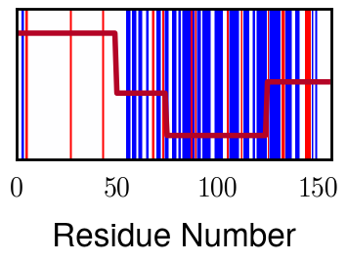
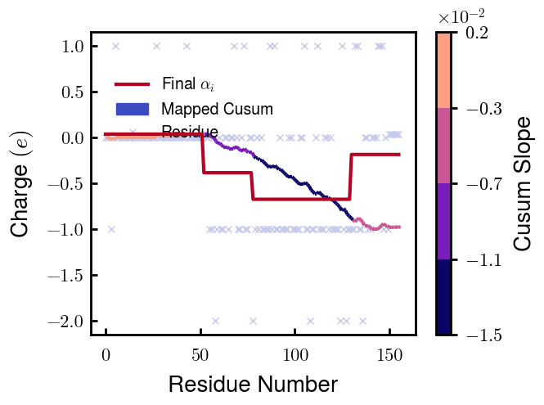
NFL, pH 7.44, phos
 | Slope Bins 4 | Smear Count 25
Block number | Alpha w/ Henderson Hasselbalch | Chi Chi_max = 3.2
[0 50] | 0.040012 | 1.540000
[50 75] | -0.358451 | 0.960000
[75 125] | -0.639707 | 0.868000
[125 156] | -0.283485 | 0.690323

Slide 14
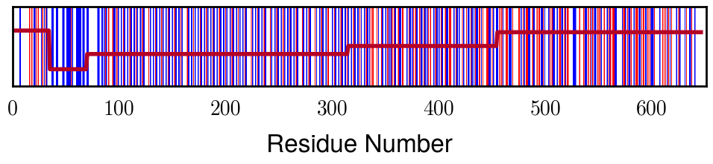
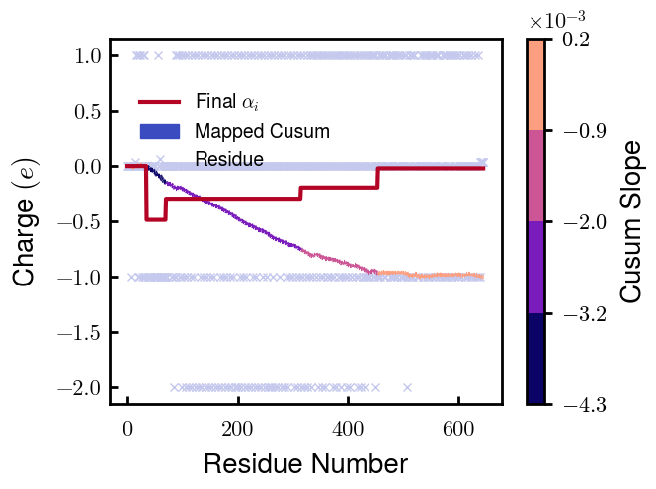
NFH, pH 7.44, phos
 | Slope Bins 4 | Smear Count 35
Block number | Alpha w/ Henderson Hasselbalch | Chi Chi_max = 3.2
[0 35] | 0.000972 | 1.211429
[35 70] | -0.485419 | 1.017143
[70 315] | -0.293915 | 1.708571
[315 455] | -0.192910 | 1.370000
[455 647] | -0.019795 | 1.080208

Slide 15




b2.00 v2.70 c3.20
b2.00 v2.75 c3.20

Slide 16
NFH fitting (from NFL best fit)

Slide 17








b1.00, v0.50, c3.2
b2.00, v4.00, c3.2, th2.5e-02
b1.00, v2.00, c3.2
b1.00, v1.00, c3.2

Slide 18
Mixture

Slide 19



Slide 20


b = 0.75

Slide 21





Slide 22
b = 1.0

Slide 23





Slide 24
b = 1.25

Slide 25




Chi 2.6
Bad vol frac

Slide 26








b25v0
b25v1
b25v2
b25v3

Slide 27




Chi 2.8
Bad vol frac

Slide 28





Slide 29
b = 1.50

Slide 30






Chi 2.8
Bad vol frac

Slide 31





Slide 32

b = 2.00
v4 = 0.25*b^3

Slide 33


Bad vol frac

Slide 34



Slide 35
Fine tune

Slide 36



b1.25, v1.95, c3.0
b1.50, v3.38, c3.0
b2.00, v4.00, c3.0
Norm seems to capture kinked behavior

Slide 37




Slide 38



b1.25, v1.95, c3.2
b1.50, v3.38, c3.2
b2.00, v4.00, c3.2

Slide 39




Slide 40


b1.25
b1.50
b2.00
c2.8
c3.0
c3.2

